Slide 1
Hybrid robust iris recognition approach using iris image processing, two-dimensional gabor features and Multi Layer Perceptron Neural Network/PSO
Hybrid robust iris recognition approach using iris image processing, two-dimensional gabor features and Multi Layer Perceptron Neural Network/PSO
Christo Joby
Class No:21 S7 B-Tech CSE
Dept. of CSE,MACE Kothamangalam
NOvember 2018

Slide 2
Contents Covered
Hybrid robust iris recognition approach using iris image processing, two-dimensional gabor features and Multi Layer Perceptron Neural Network/PSO
Introduction
Importance of Iris Biometrics
Problem Explanation
Procedure for Iris Recognition
Preliminaries
Pre-Processing
2D Gabor Filtration
Multi-Layer Perceptron Network
Particle Swarm Optimisation

Slide 3
Contents Covered (Contd.)
Architecture
Results
Conclusion

Slide 4
Introduction
Hybrid robust iris recognition approach using iris image processing, two-dimensional gabor features and Multi Layer Perceptron Neural Network/PSO
What are biometric technology?
-Biometrics [Biological measurement]
-Traditional method of identification (password, card, PIN)
Why iris recognition?
Basic working.
-Failure of a test of a statistical independence

Slide 5
Importance of Iris Biometric
Hybrid robust iris recognition approach using iris image processing, two-dimensional gabor features and Multi Layer Perceptron Neural Network/PSO
Crime Rate
Fraud in Applications
Unauthorized Access

Slide 6
Problem Explanation
Hybrid robust iris recognition approach using iris image processing, two-dimensional gabor features and Multi Layer Perceptron Neural Network/PSO
Tallapragada and Rajan Iris Recognition method
GLCM + Haar Wavelet
Accuracy Rate
Solution to the problem
- 2-D Gabor Kernel and MLPNN/PSO implementation

Slide 7
Steps Involved in Iris Recognition
Hybrid robust iris recognition approach using iris image processing, two-dimensional gabor features and Multi Layer Perceptron Neural Network/PSO
Acquisition
Segmentation
Normalization
Encoding
Database Enrollment
Matching
Decision

Slide 8
Premliminaries
Hybrid robust iris recognition approach using iris image processing, two-dimensional gabor features and Multi Layer Perceptron Neural Network/PSO
Image Pre-processing
Localisation
Normalisation
Segmentation

Slide 9
Preliminaries (Contd.)
Hybrid robust iris recognition approach using iris image processing, two-dimensional gabor features and Multi Layer Perceptron Neural Network/PSO
2-D Gabor Kernel Method
Pattern Matching
MLPNN – PSO Method for performance enhancement.

Slide 10
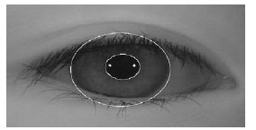
Image Pre-processing
Iris Localisation
Gray Scale Conversion
Circular Hough
Transform
Detection of circular Boundaries of Pupil and Iris
Fig. 1.
(Courtesy :https://arXiv https://arxiv.org/pdf/1111.5135)

Slide 11
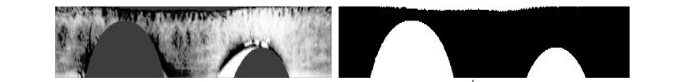
Image Pre-processing (Contd.)
Hybrid robust iris recognition approach using iris image processing, two-dimensional gabor features and Multi Layer Perceptron Neural Network/PSO
Iris Normalisation
Cartesian to Polar Coordinates
Fig. 2.
(Courtesy: https://ieeexplore.ieee.org/document/8302830)

Slide 12
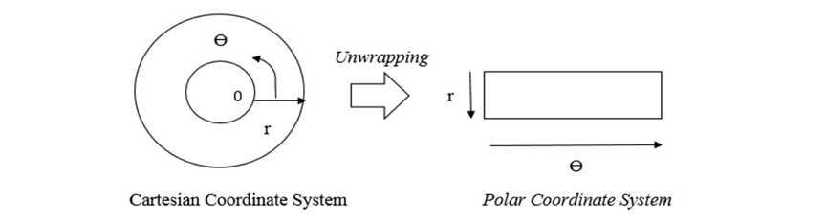
Image Pre-processing (Contd.)
Hybrid robust iris recognition approach using iris image processing, two-dimensional gabor features and Multi Layer Perceptron Neural Network/PSO
Daugman Rubber Sheet model
I(x(r, θ), y(r, θ)) → I(r, θ) (1)
x(r, θ) = (1 − r)xp(θ) + rxl(θ) (2)
y(r, θ) = (1 − r)yp(θ) + ryl(θ) (3)
Fig. 3.
(Courtesy: https://ieeexplore.ieee.org/document/8302830)

Slide 13
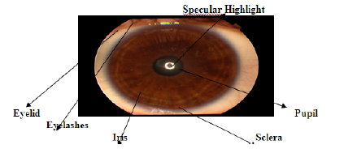
Image Pre-processing (Contd.)
Hybrid robust iris recognition approach using iris image processing, two-dimensional gabor features and Multi Layer Perceptron Neural Network/PSO
Image Segmentation
Isolation of Eye Features.
Fig 4.
(Courtesy : https://ieeexplore.ieee.org/document/5571456)

Slide 14

2-D Gabor Kernel Method
Hybrid robust iris recognition approach using iris image processing, two-dimensional gabor features and Multi Layer Perceptron Neural Network/PSO
Encoding of the feature extraction
2D Gabor wavelets
Optimum Conjoint Representation
Spatial Domain of the Gabor Filter

Slide 15
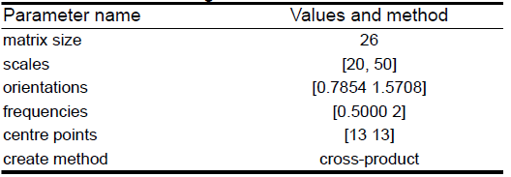
2-D Gabor Kernel Method (Contd.)
Hybrid robust iris recognition approach using iris image processing, two-dimensional gabor features and Multi Layer Perceptron Neural Network/PSO
Parameters for setting the Gabor Filtering

Slide 16


Multi-Layer Perceptron NN
Hybrid robust iris recognition approach using iris image processing, two-dimensional gabor features and Multi Layer Perceptron Neural Network/PSO
Pattern Matching Technique
Final Layer Output from Error Function
Updating the weights

Slide 17
Algorithm For MLPNN
Hybrid robust iris recognition approach using iris image processing, two-dimensional gabor features and Multi Layer Perceptron Neural Network/PSO
1. Selection of training patterns for the learning network.
2. Defining N input, N − 1 hidden layers, and N output as fully connected layers with their prior layers by weight of connection.
3. Random production of initial weights.

Slide 18
Algorithm For MLPNN(Contd.)
4. Choosing error function E(w) and η correctly.
5. updating the weight of all weights (w) and all training patterns (p) Δw = − η∂E(w)/∂w
6. Repetition of step 5 until the error function of the network becomes sufficiently small.

Slide 19


Particle Swarm Optimization (PSO)
Hybrid robust iris recognition approach using iris image processing, two-dimensional gabor features and Multi Layer Perceptron Neural Network/PSO
Based on Population of the Particles
PSO benefits from distinct optimisation algorithms.
Position of the Particles are calculated by:
Speed and Randomness is updated by:

Slide 20
Algorithm for PSO
Hybrid robust iris recognition approach using iris image processing, two-dimensional gabor features and Multi Layer Perceptron Neural Network/PSO
Define the preliminary particle.
Compute the fitness function for all particles.
Continue with step 4 if step 3> personal best; otherwise go to step 5.
Allot the values of the present fitness to new personal jump to step 6.

Slide 21
Algorithm for PSO (Contd.)
5. Save prior personal best. Go to step 6.
6. Allot the personal best of the best particle for the global best.
7. Compute the velocity of all particles.
8. Use the velocity values to update the data for all particles.
9. If the target attained, continue to step 10; otherwise repeat steps 2–9.

Slide 22


MLPNN – PSO Combined method
Hybrid robust iris recognition approach using iris image processing, two-dimensional gabor features and Multi Layer Perceptron Neural Network/PSO
Feature Extraction combined formula:
Obtained by Trial and Error.
Gabor Extraction is done by:

Slide 23
Architecture
Hybrid robust iris recognition approach using iris image processing, two-dimensional gabor features and Multi Layer Perceptron Neural Network/PSO
Accuracy of the Weights
100 Neurons in the hidden Layer.
280 inputs to pre-processed Iris Images.
One Neuron to the Output layer.
MLPNN modified by PSO

Slide 24
Architecture (Contd.)
Hybrid robust iris recognition approach using iris image processing, two-dimensional gabor features and Multi Layer Perceptron Neural Network/PSO
PSO is located in the Outer and Inner Loops.
Inner Loop - training error.
Outer Loop - Neural Network Structure.
100 * 486 number of neurons used. (486 inputs)
Layer Weight of 100*1. (100 neurons and 1 Output)

Slide 25
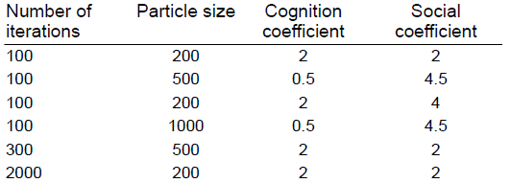
Architecture (Contd.)
Hybrid robust iris recognition approach using iris image processing, two-dimensional gabor features and Multi Layer Perceptron Neural Network/PSO
Cost Function of the algorithm.
Minimize the Error
Parameters of the PSO Algorithm:

Slide 26
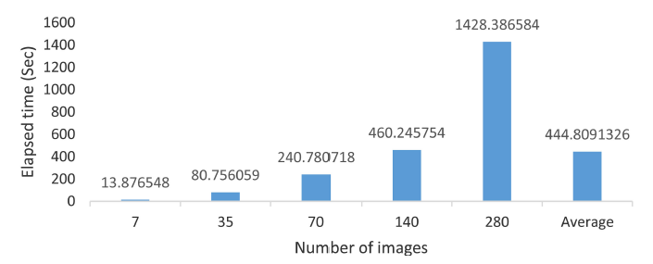
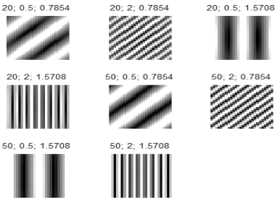
Results
Hybrid robust iris recognition approach using iris image processing, two-dimensional gabor features and Multi Layer Perceptron Neural Network/PSO
2D Gabor Filter Feature
Extraction
Fig. 5.
(Courtesy: https://ieeexplore.ieee.org/document/8302830)
Gabor Filter Bank
Fig. 6. (Courtesy: https://ieeexplore.ieee.org/document/8302830)

Slide 27
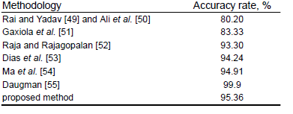
Results (Contd.)
Hybrid robust iris recognition approach using iris image processing, two-dimensional gabor features and Multi Layer Perceptron Neural Network/PSO
For the proposed method CASIA-v3 Dataset has been used.

Slide 28
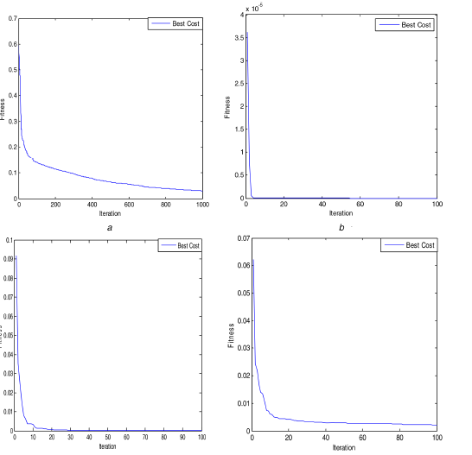
Results (Contd.)
Hybrid robust iris recognition approach using iris image processing, two-dimensional gabor features and Multi Layer Perceptron Neural Network/PSO
The resultant images are shown in Fig. 7. As seen, the network with the PSO algorithm was trained precisely and obtained a high rate of accuracy.
Fig. 7.(Courtesy: https://ieeexplore.ieee.org/document/8302830)

Slide 29
Conclusion
Hybrid robust iris recognition approach using iris image processing, two-dimensional gabor features and Multi Layer Perceptron Neural Network/PSO
MLPNN and PSO used for Classification
2D Gabor Filter Algorithm was used for feature extraction.
Opens a new chamber
Experimental outcomes were better.

Slide 30
References
Hybrid robust iris recognition approach using iris image processing, two-dimensional gabor features and Multi Layer Perceptron Neural Network/PSO
[1] Tisse, C.L., Martin, L., Torres, L., et al.: ‘Person identification technique using human iris recognition’. Proc. Vision Interface, 2002, pp. 294–299
[2] Delac, K., Grgic, M.: ‘A survey of biometric recognition methods’. 46th IEEE Int. Proc. Symp. Electronics and Marine, 2004, pp. 184–193
[3] Jain, A.K., Ross, A., Pankanti, S.: ‘Biometrics: a tool for information security’, IEEE Trans. Inf. Forensics Sec., 2006, 1, (2), pp. 125–143
[4] Yan, S., Xu, D., Zhang, B.: ‘Graph embedding and extensions: a general framework for dimensionality reduction’, IEEE Trans. Pattern Anal. Mach. Intell., 2007, 29, (1), pp. 40–51
[5] Ahmadi, N., Akbarizadeh, G.: ‘A review of iris recognition based on biometric technologies’, Transylvanian Rev., 2016, 24, (4), pp. 151–163
[6] Alheeti, K.M.A.: ‘Biometric iris recognition based on hybrid technique’, Int. J. Soft Comput., 2011, 2, (4), p. 1
[7] Tallapragada, V.S., Rajan, E.G.: ‘Morphology based non-ideal iris recognition using decision tree classifier’. IEEE Int. Conf. Pervasive Computing (ICPC), 2015, pp. 1–4
[8] Daugman, J.G.: U.S. Patent No. 5,291,560, U.S. Patent and Trademark Office, Washington, DC, 1994
[9] Abiyev, R.H., Altunkaya, K.: ‘Neural network based biometric personal identification with fast iris segmentation’, Int. J. Control Autom. Syst., 2009, 7, (1), pp. 17–23

Slide 31
Reference (Contd.)
Hybrid robust iris recognition approach using iris image processing, two-dimensional gabor features and Multi Layer Perceptron Neural Network/PSO
[10] Cho, S., Kim, J.: ‘Iris recognition using LVQ neural network’. Int. Symp. Neural Networks, 2006, pp. 26–33
[11] Srivastava, V., Tripathi, B.K., Pathak, V.K.: ‘Biometric recognition by hybridization of evolutionary fuzzy clustering with functional neural networks’, J. Ambient Int. Humanized Comput., 2014, 5, (4), pp. 525–537
[12] Ye, X., Yao, P., Long, F.: ‘Iris image real-time pre-estimation using compound BP neural network’. Int. Conf. Biometrics, 2006, pp. 450–456
[13] Ma, Z., Qi, M., Kang, : ‘Iris verification using wavelet moments and neural network’. Int. Conf. Life System Modeling and Simulation, 2007, pp. 218–226
[14] Dhage, S.S., Hegde, S.S., Manikantan, K.: ‘DWT-based feature extraction and radon transform based contrast enhancement for improved iris recognition’, Proc. Comput. Sci., 2015, 45, pp. 256–265
[15] Chen, C.H., Chu, C.T.: ‘High performance iris recognition based on 1-D circular feature extraction and PSO–PNN classifier’, Expert Syst. Appl., 2009, 36, (7), pp. 10351–10356.

Slide 32
THANK YOU!
Hybrid robust iris recognition approach using iris image processing, two-dimensional gabor features and Multi Layer Perceptron Neural Network/PSO

